Slide 1
ECE 532
CHAPTER 4: GRAPHS (PART 1: INTRODUCTION INTO GRAPHS)
Lecturer: Dr. Roslina Mohamad
Room: Tower 2, Level 13, No:14C

Slide 2
Learning Outcomes
In this chapter, you will:
Learn about graphs
Learn the basic terminology of graph theory
Explore the graph representations

Slide 3
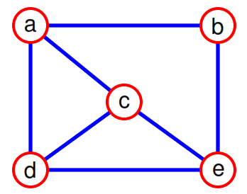
What is a Graph?
• A graph G = (V,E) is composed of:
V: set of vertices
E: set of edges connecting the vertices in V
• An edge e = (u,v) is a pair of vertices
Example:V= {a,b,c,d,e}, E={(a,b),(a,c),(a,d),(b,e),(c,d),(c,e),(d,e)}

Slide 4
Definition
A graph G consists of two sets
a finite, nonempty set of vertices V(G)
a finite, possible empty set of edges E(G)
G(V,E) represents a graph

Slide 5
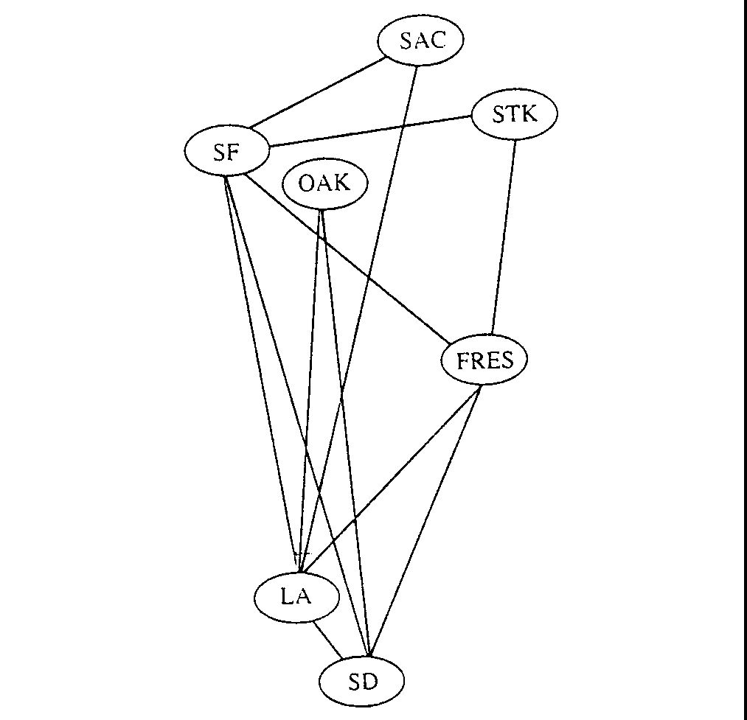
e.g. Airline Routes

Slide 6
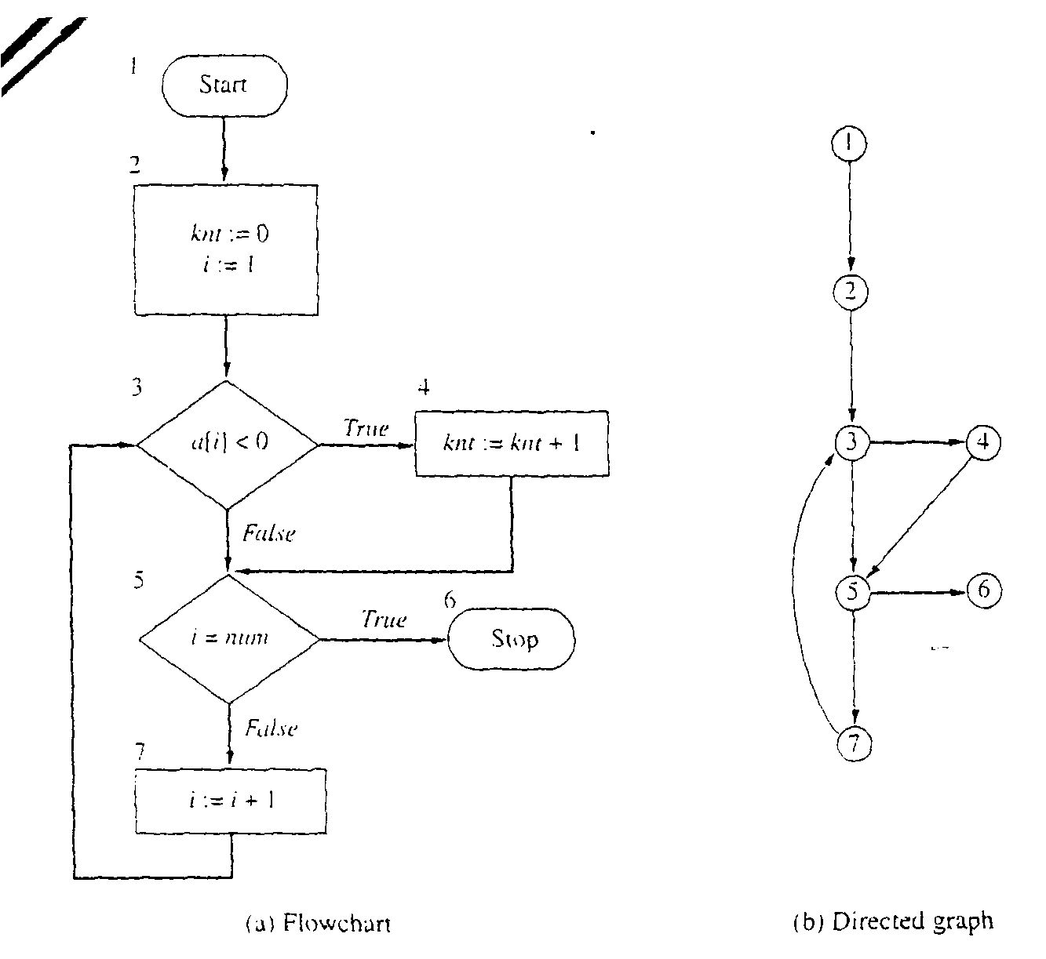
e.g. Flowcharts

Slide 7
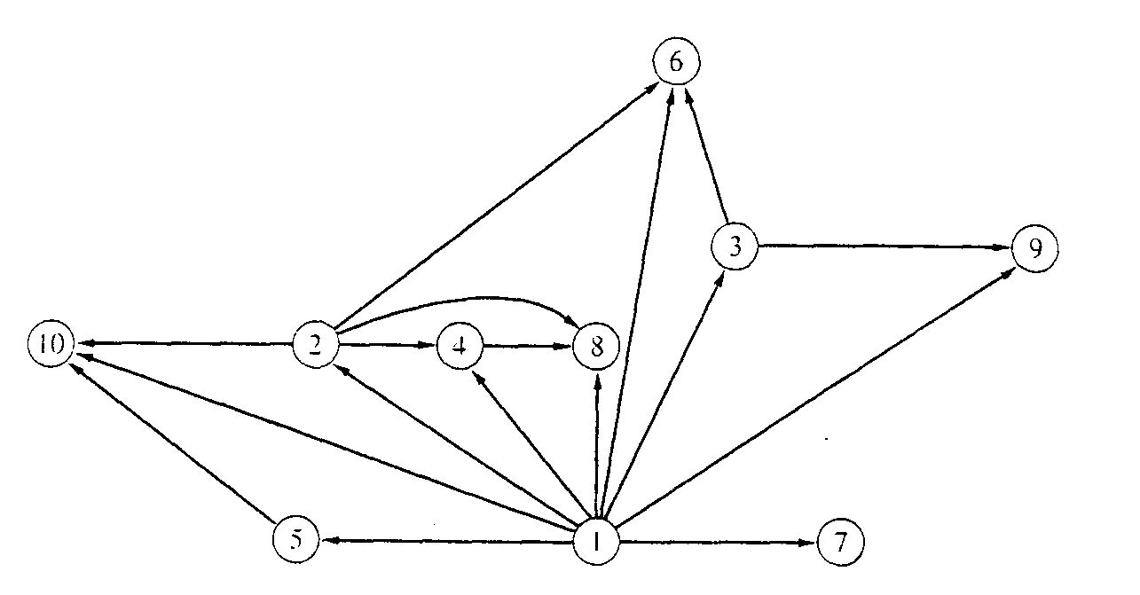
Binary relation
x is a proper factor of y

Slide 8
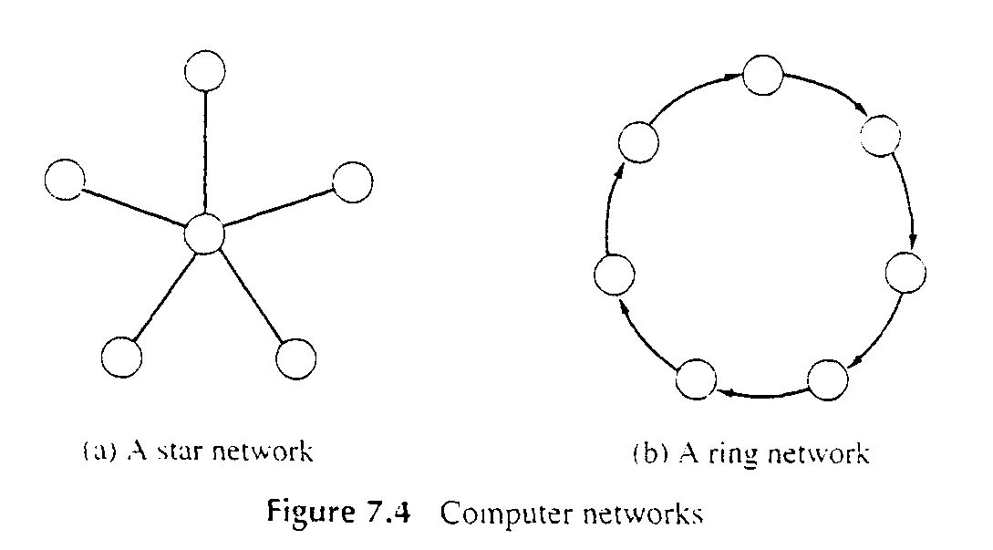
e.g. Computer Networks

Slide 9
Types of Graph
A directed graph is one in which each edge is a directed pair of vertices, <v0, v1> != <v1,v0>
An undirected graph is one in which the pair of vertices in a edge is unordered, (v₀, v₁) = (v₁,v₀)
tail
head

Slide 10
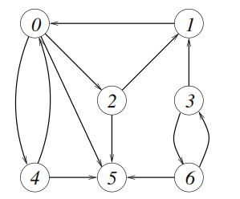
10
A directed graph
G=( V , E ) with vertex set
V={0, 1, 2, 3, 4, 5, 6}
and edge set
E= {(0, 2), (0, 4), (0, 5), (1, 0), (2, 1), (2, 5), (3, 1), (3, 6), (4, 0), (4, 5), (6, 3), (6, 5)

Slide 11
11
An
undirected
graph
1
2
0
3
10
11
4
9
12
5
8
6
7

Slide 12
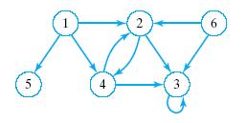
Directed Graphs
Similar to a tree
Consists of a finite set of elements
Vertices or nodes
Together with finite set of directed
Arcs or edges
Connect pairs of vertices

Slide 13
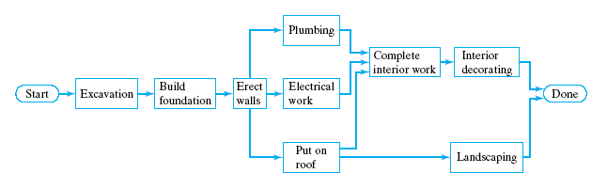
Directed Graphs
Applications of directed graphs
Analyze electrical circuits
Find shortest routes
Develop project schedules

Slide 14
Directed Graphs
Trees are special kinds of directed graphs
One of their nodes (the root) has no incoming arc
Every other node can be reached from the node by a unique path
Graphs differ from trees
Insertion of a node does not require a link (arc) to other nodes … or may have multiple arcs

Slide 15
Directed Graphs
A directed graph is defined as a collection of data elements:
Called nodes or vertices
And a finite set of direct arcs or edges
The edges connect pairs of nodes
Operations include
Constructors
Inserts of nodes, of edges
Deletions of nodes, edges
Search for a value in a node, starting from a given node

Slide 16
Complete Graph
A complete graph is a graph that has the maximum number of edges
for undirected graph with n vertices, the maximum number of edges is n(n-1)/2
for directed graph with n vertices, the maximum number of edges is n(n-1)
example: G1 is a complete graph

Slide 17
Examples for Graph
0
0
0
1
2
1
2
1
3
3
4
5
6
G1
2
G2
complete graph
incomplete graph
G3
V(G1)={0,1,2,3} E(G1)={(0,1),(0,2),(0,3),(1,2),(1,3),(2,3)}
V(G2)={0,1,2,3,4,5,6} E(G2)={(0,1),(0,2),(1,3),(1,4),(2,5),(2,6)}
V(G3)={0,1,2} E(G3)={<0,1>,<1,0>,<1,2>}
complete undirected graph: n(n-1)/2 edges
complete directed graph: n(n-1) edges

Slide 18
Graph Definitions and Notations
a ∈ X: a is an element of the set X
Subset (Y ⊆ X): every element of Y is also an element of X
Intersection (A ∩ B): contains all the elements in A and B
A ∩ B = {x | x ∈ A and x ∈ B}
Union (A ∪ B): set of all the elements that are in A or in B
A ∪ B = {x | x ∈ A or x ∈ B}

Slide 19
Graph Definitions and Notations (cont’d.)
A × B: set of all the ordered pairs of elements of A and B
A × B = {(a, b) | a ∈ A, b ∈ B}
Graph G: G = (V, E)
V is a finite nonempty set of vertices of G
E ⊆ V × V
Elements in E are the pairs of elements of V
E is called set of edges

Slide 20
The Graph Terminology
Adjacent (connected by an edge) and Incident (An edge and a vertex on that edge)
If (v0, v1) is an edge in an undirected graph,
v0 and v1 are adjacent
The edge (v0, v1) is incident on vertices v0 and v1
If <v0, v1> is an edge in a directed graph
v0 is adjacent to v1, and v1 is adjacent from v0
The edge <v0, v1> is incident on v0 and v1
V₀
V₁
V₀
V₁

Slide 21
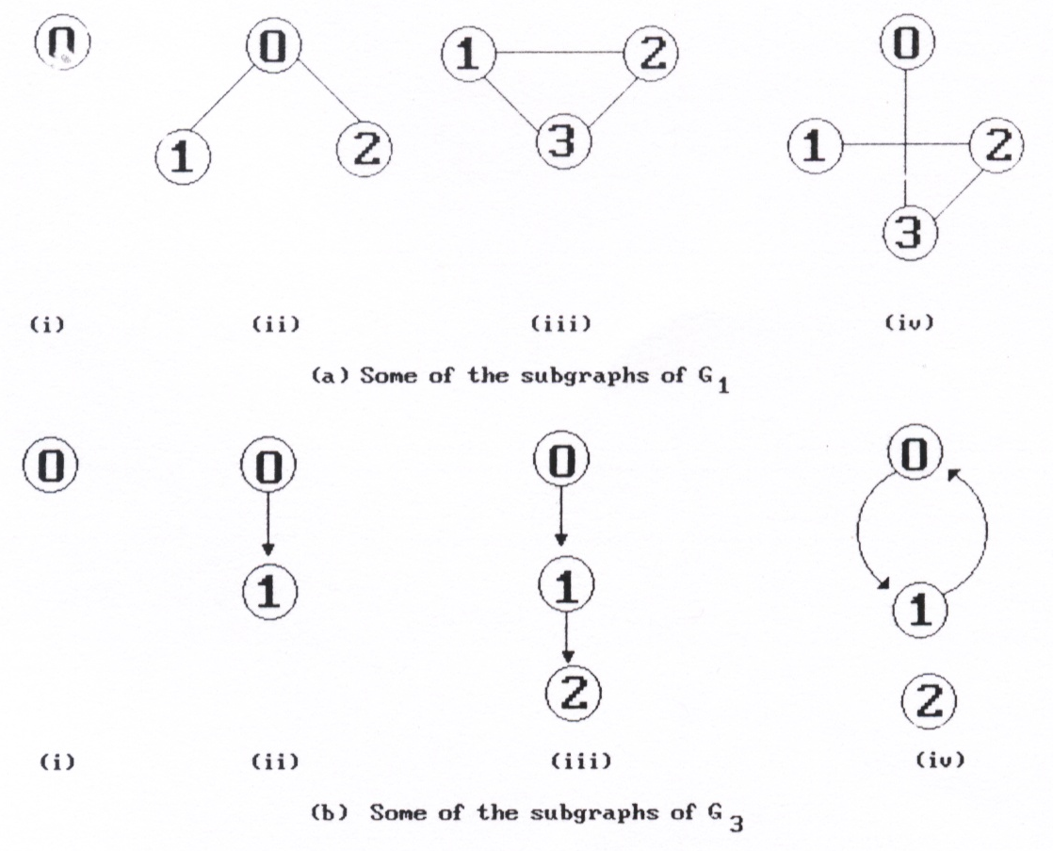
The Graph Terminology
A subgraph of G is a graph G’ such that V(G’) ⊆ V(G) and E(G’) ⊆ E(G).
0
1
2
3
G1
0
1
2
G3

Slide 22
The Graph Terminology
Path
A path from vertex vp to vertex vq in a graph G, is a sequence of vertices, vp, vi1, vi2, ..., vin, vq, such that (vp, vi1), (vi1, vi2), ..., (vin, vq) are edges in an undirected graph.
A path such as (0, 2), (2, 1), (1, 3) is also written as 0, 2, 1, 3
The length of a path is the number of edges on it
0
0
0
1
2
1
2
1
2
3
3
3

Slide 23
The Graph Terminology
Simple path and cycle
simple path (simple directed path): a path in which all vertices, except possibly the first and the last, are distinct.
A cycle is a simple path in which the first and the last vertices are the same.
0
1
2
3

Slide 24
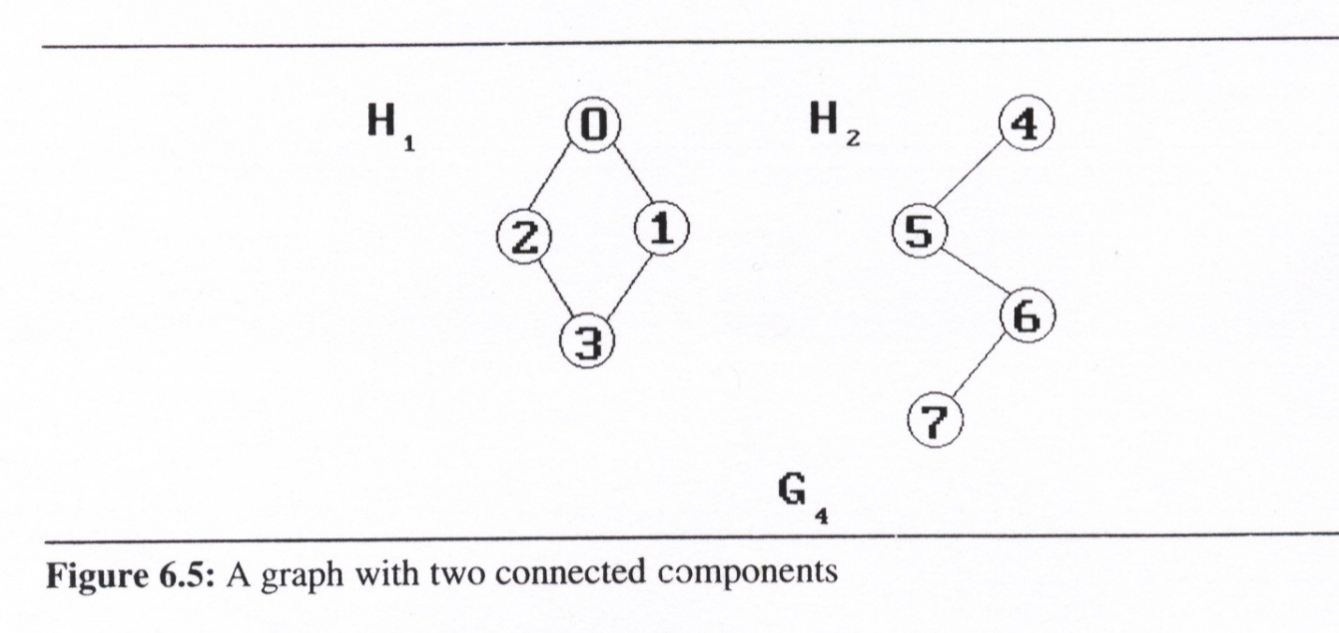
The Graph Terminology
Connected graph
In an undirected graph G, two vertices, v₀ and v₁, are connected if there is a path in G from v₀ to v₁
An undirected graph is connected if, for every pair of distinct vertices v_{i}, v_{j}, there is a path from v_{i} to v_{j}
Connected component
A connected component of an undirected graph is a maximal connected subgraph.
A tree is a graph that is connected and acyclic (i.e, has no cycle).

Slide 25
The Graph Terminology
Strongly Connected Component
A directed graph is strongly connected if there is a directed path from vi to vj and also from vj to vi
A strongly connected component is a maximal subgraph that is strongly connected
0
strongly connected component
(maximal strongly connected subgraph)
0
1
2
not strongly connected
1
2
G3

Slide 26
The Graph Terminology
Degree
The degree of a vertex is the number of edges incident to that vertex.
For directed graph
in-degree (v) : the number of edges that have v as the head
out-degree (v) : the number of edges that have v as the tail
If di is the degree of a vertex i in a graph G with n vertices and e edges, the number of edges is

Slide 27
The Graph Terminology
Degree (cont’d)
We shall refer to a directed graph as a digraph. When we us the term graph, we assume that it is an undirected graph
directed graph
undirected graph
in-degree & out-degree
degree
2
0
in:1, out: 1
3
0
0
3
3
1
2
1
in: 1, out: 2
3
1
2
3
1
1
1
1
3
3
4
5
6
2
in: 1, out: 0
3
G1
G2
G3

Slide 28
Graph Terminology

Slide 29
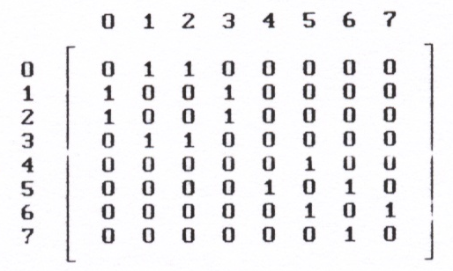
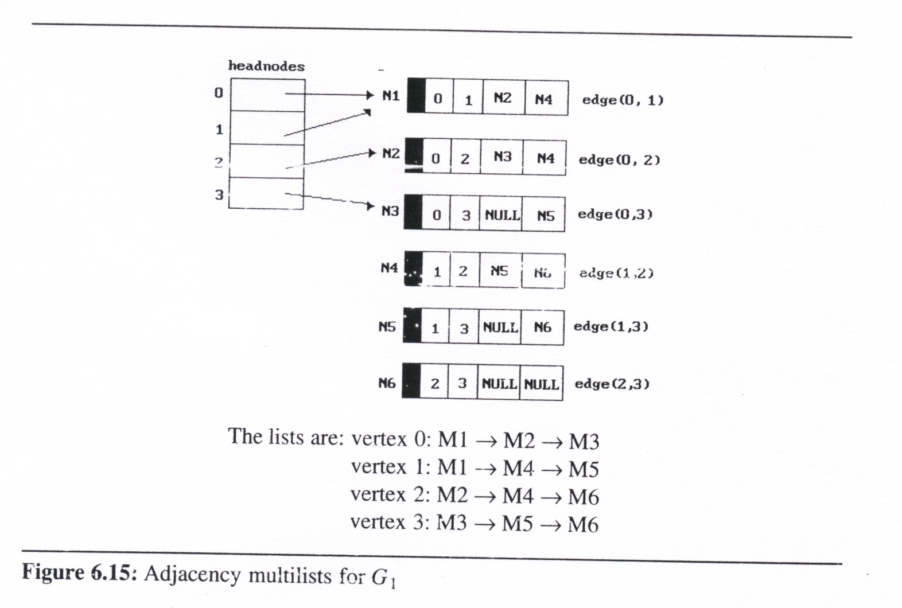
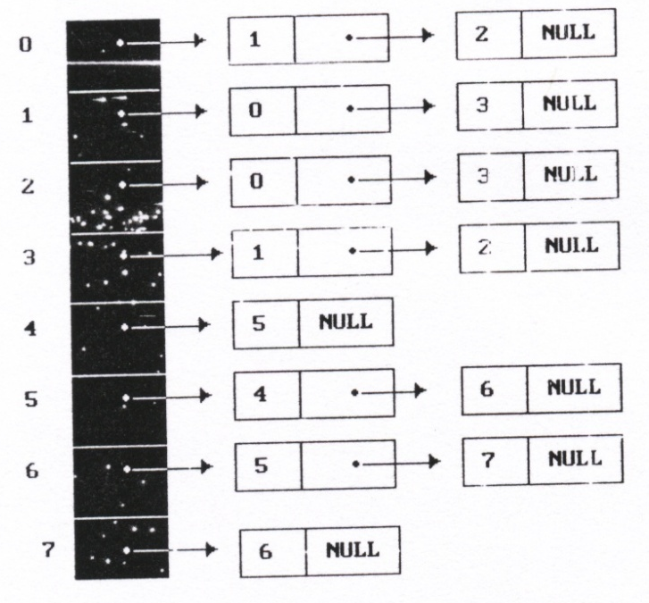
Graph Representations
Adjacency Matrix
Adjacency Lists
Adjacency Multilists

Slide 30
Adjacency Matrix Representation
Adjacency matrix representation
for directed graph with vertices numbered 1, 2, … n
Defined as n by n matrix named adj
The [i,j] entry set to
1 (true) if vertex j is adjacent to vertex i (there is a directed arc from i to j)
0 (false) otherwise

Slide 31
Adjacency Matrix
4
Adjacency Matrix
Let G = (V,E) be a graph with n vertices.
The adjacency matrix of G is a two-dimensional n x n array, say adj_mat
If the edge (vi, vj) is(not) in E(G), adj_mat[i][j]=1(0)
The adjacency matrix for an undirected graph is symmetric; the adjacency matrix for a digraph need not be symmetric
5
6
7
0
2
1
3
G4
0
0
1
2
1
3
G1
2
G3

Slide 32
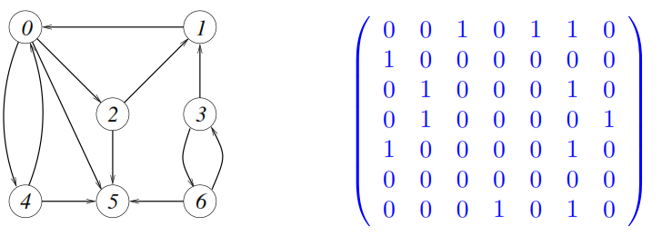
Adjacency Matrix

Slide 33
Adjacency Matrix
Merits of Adjacency Matrix
For an undirected graph, the degree of any vertex, i, is its row sum:
For a directed graph, the row sum is the out-degree, while the column sum is the in-degree.
The complexity of checking edge number or examining if G is connect
G is undirected: O(n²/2)
G is directed: O(n²)

Slide 34
Adjacency Lists
Adjacency lists
There is one list for each vertex in G. The nodes in list i represent the vertices that are adjacent from vertex i
For an undirected graph with n vertices and e edges, this representation requires n head nodes and 2e list nodes

Slide 35
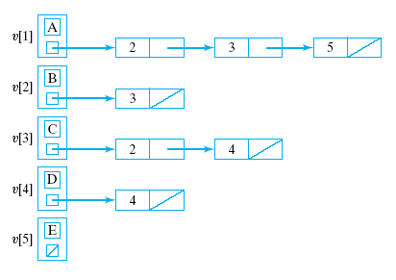
Adjacency List Representation
Solving problem of wasted space
Better to use an array of pointers to linked row-lists
This is called an Adjacency-list representation

Slide 36
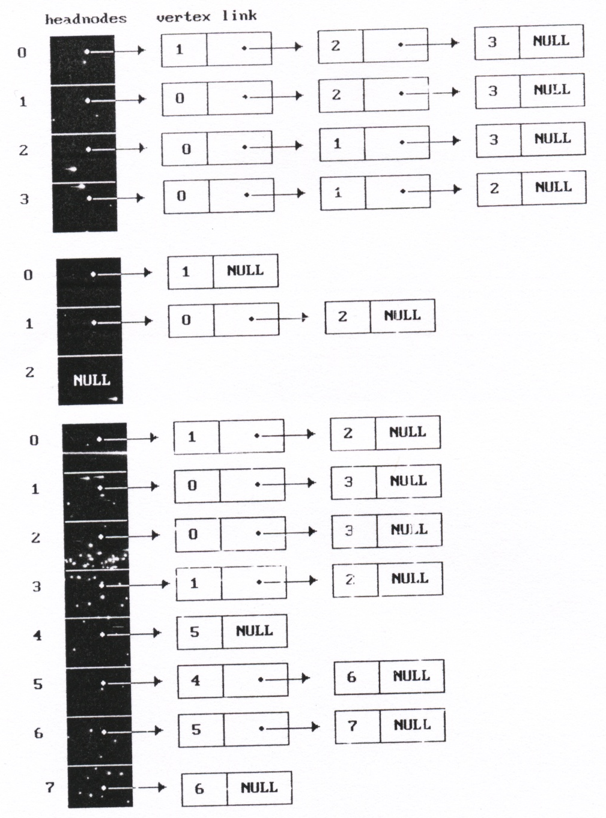
Adjacency Lists
Example
0
1
2
G3
G1
3
0
G4
1
0
4
2
1
5
2
3
6
7

Slide 37
Adjacency Lists
Vertices in Any Order
Order is of no significance
Head nodes vertex links
0
•
3 •
1 •
2 NULL
0
1
•
2 •
0 •
3 NULL
1
2
2
•
3 •
0 •
1 NULL
3
3
•
2 •
1 •
0 NULL

Slide 38
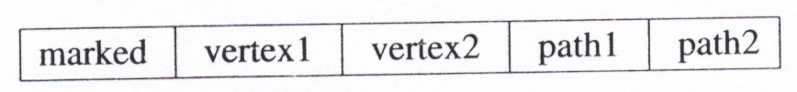
Adjacency Multilists Representations
Adjacency Multilists
Lists in which nodes may be shared among several lists. (an edge is shared by two different paths)
There is exactly one node for each edge.
This node is on the adjacency list for each of the two vertices it is incident to

Slide 39
Adjacency Multilists Representations
0
1
2
3

